Slide 1
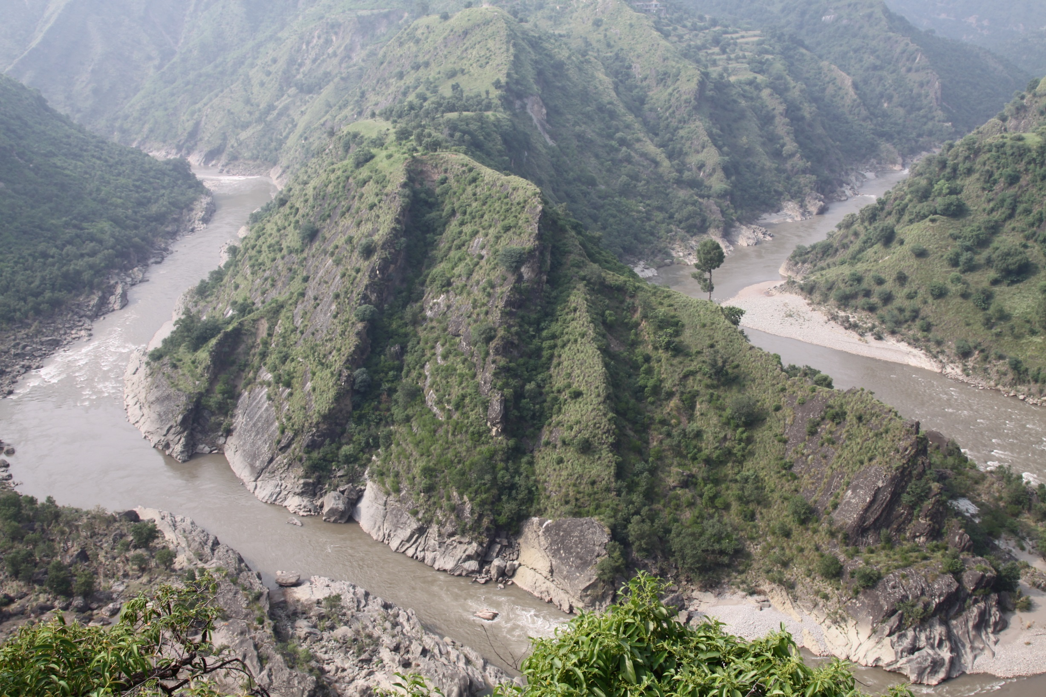
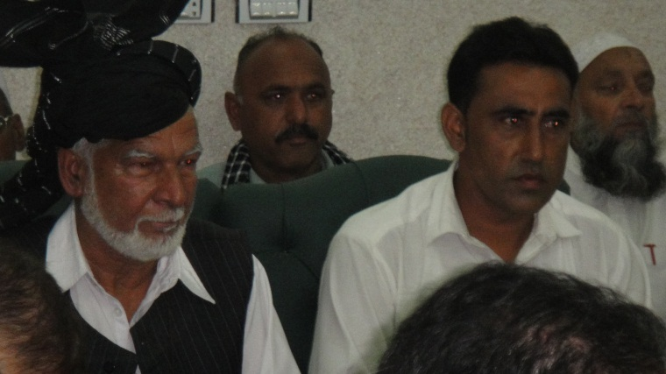
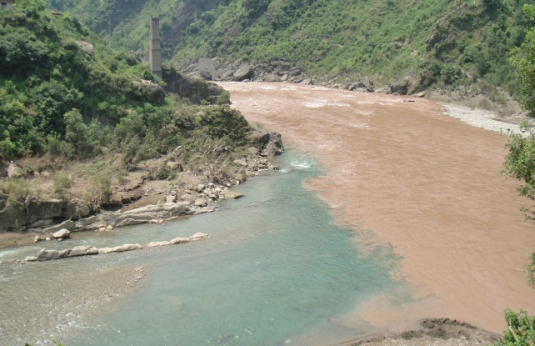
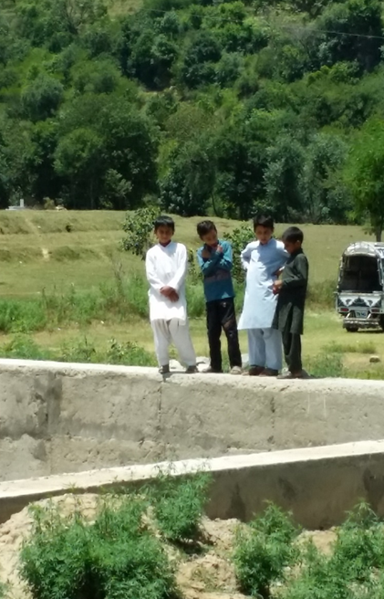
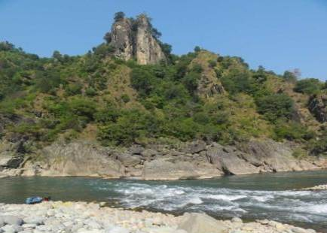
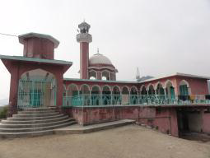
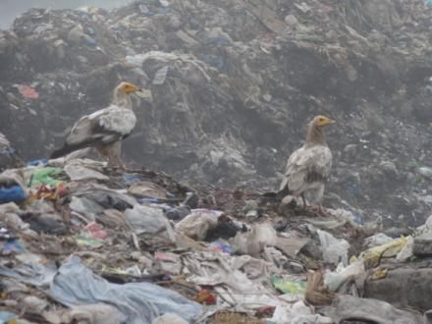
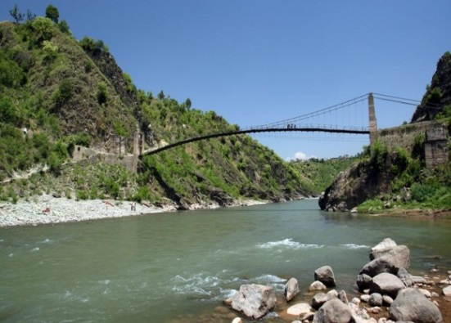

Cumulative Impact Assessment of Hydropower Development in Pakistan:
A Case Study in a Critical Habitat in the Jhelum-Poonch Rivers Watershed
Pablo Cardinale
Washington DC, November 2nd, 2016
WAB: International Association for Impact Assessment (IAIA)

Slide 2
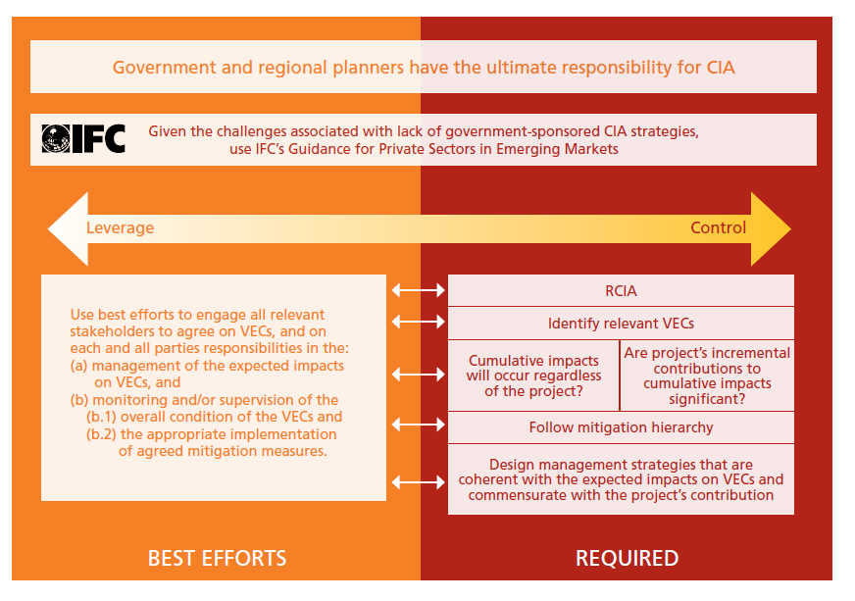
IFC Proposed Approach

Slide 3
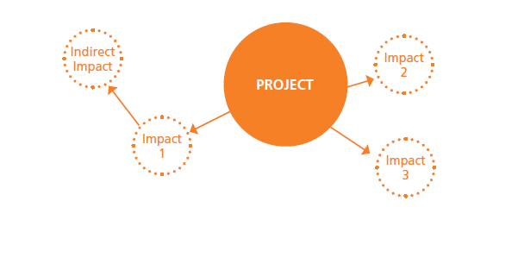
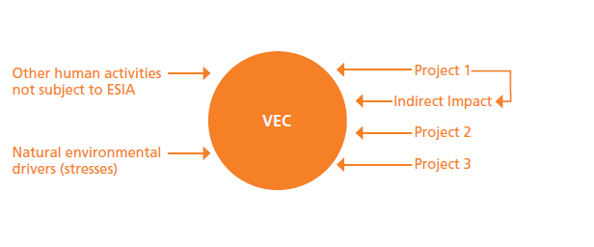
Focus: Project Centered vs VEC Centered
ESIA
CIA

Slide 4
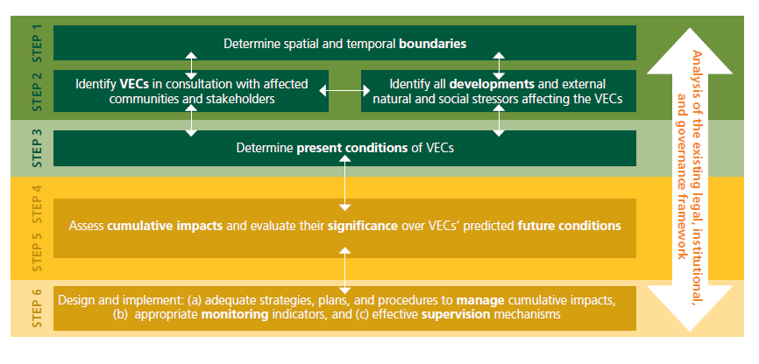
Six-Step Process

Slide 5
Case Study:
Gulpur Hydropower Project,
Pakistan

Slide 6
Gulpur HPP (Pakistan)
102 MW greenfield run-of-the-river HP project in the Kolti District, Eastern Pakistan / Azad Jammu and Kashmir (AJK) region.
Main construction to begun on late 2015
Components:
  dam 66 m high.
  @ 1000 meter diversion tunnels.
  power house and a switch yard.
  700 meters dewatered stretch.
  True run-of-river, no peak generation
  No new access roads.
  Existing transmission line.
IFC’s proposed US$ 50 million A-Loan (15% total project cost of US$332 million) and mobilization of up to US$93 million.
Co-financed with ADB, CDC, MIGA and others

Slide 7
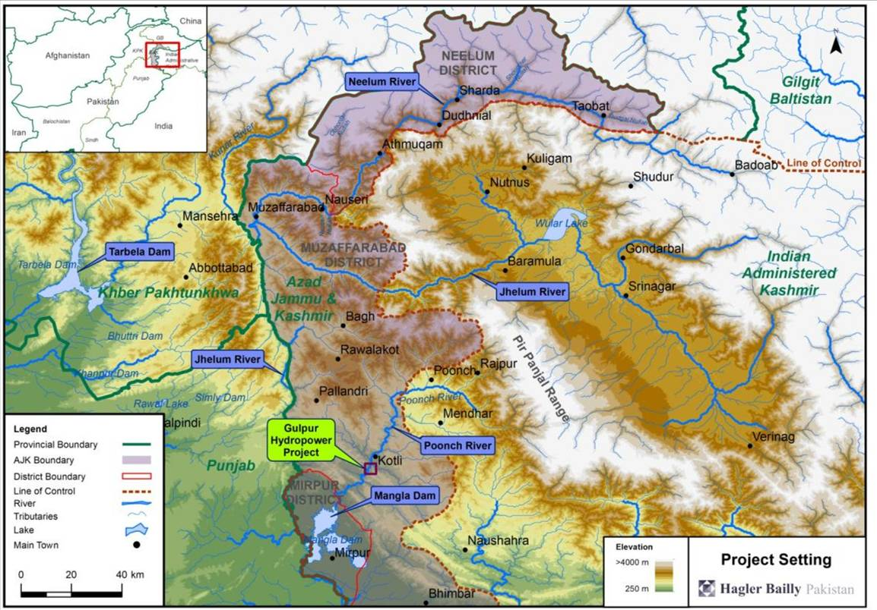

Slide 8
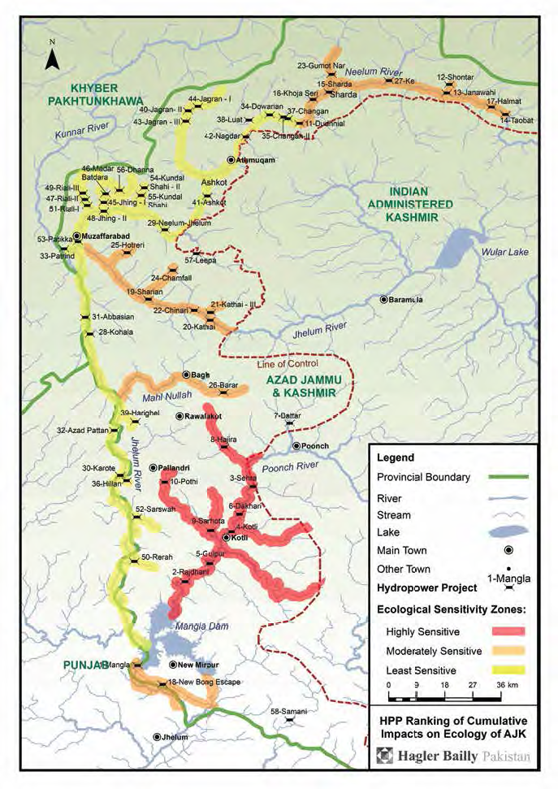
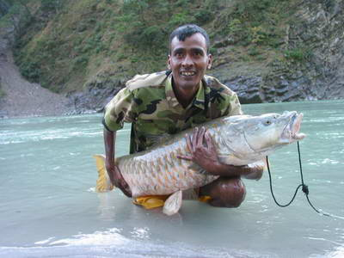
Critical Habitat – Mahaseer National Park
2014 IUCN Strategic Environmental
Assessment concluded that Poonch River is Ecologically “Highly Sensitive”
IFC determined that the Gulpur HPP
Is located in Critical Habitat (per PS6)
based on:
Regionally important population of Endangered migratory fish, Golden Mahaseer (Tor putitora)
Critically Endangered Kashmir Catfish (Glyptothorax kasmirensis)
Gulpur HPP is located within the Poonch River Mahaseer National Park
Golden Mahaseer

Slide 9
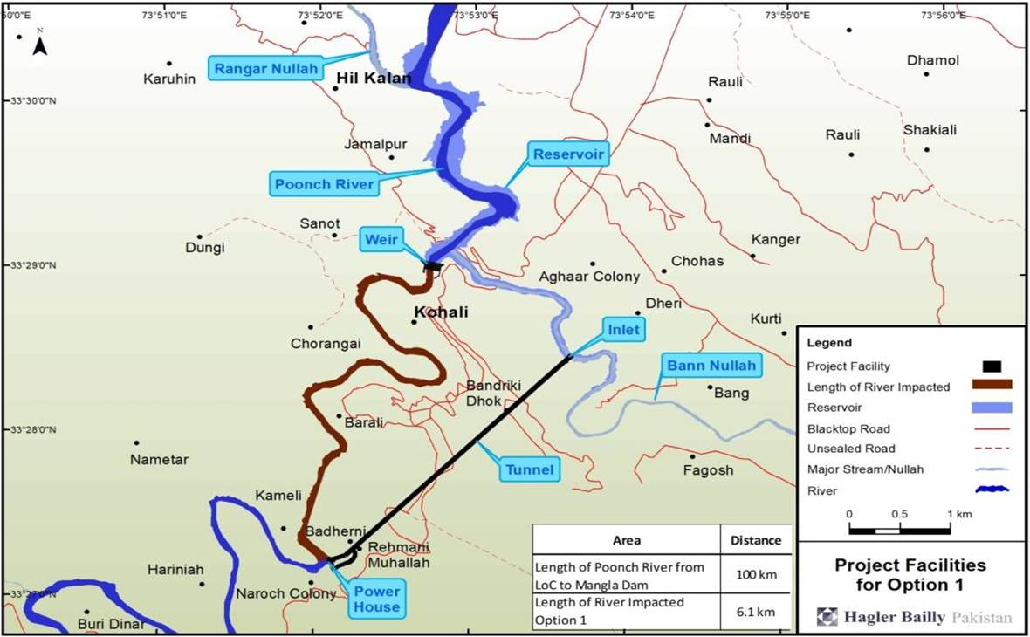
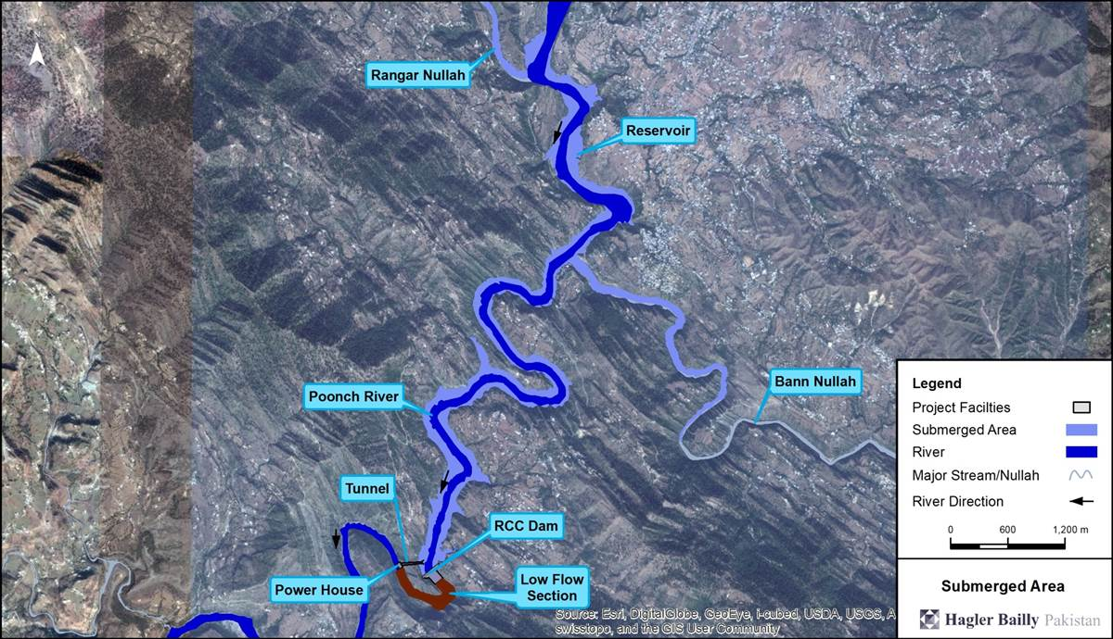
Project Approach: Alternative Analysis

Slide 11
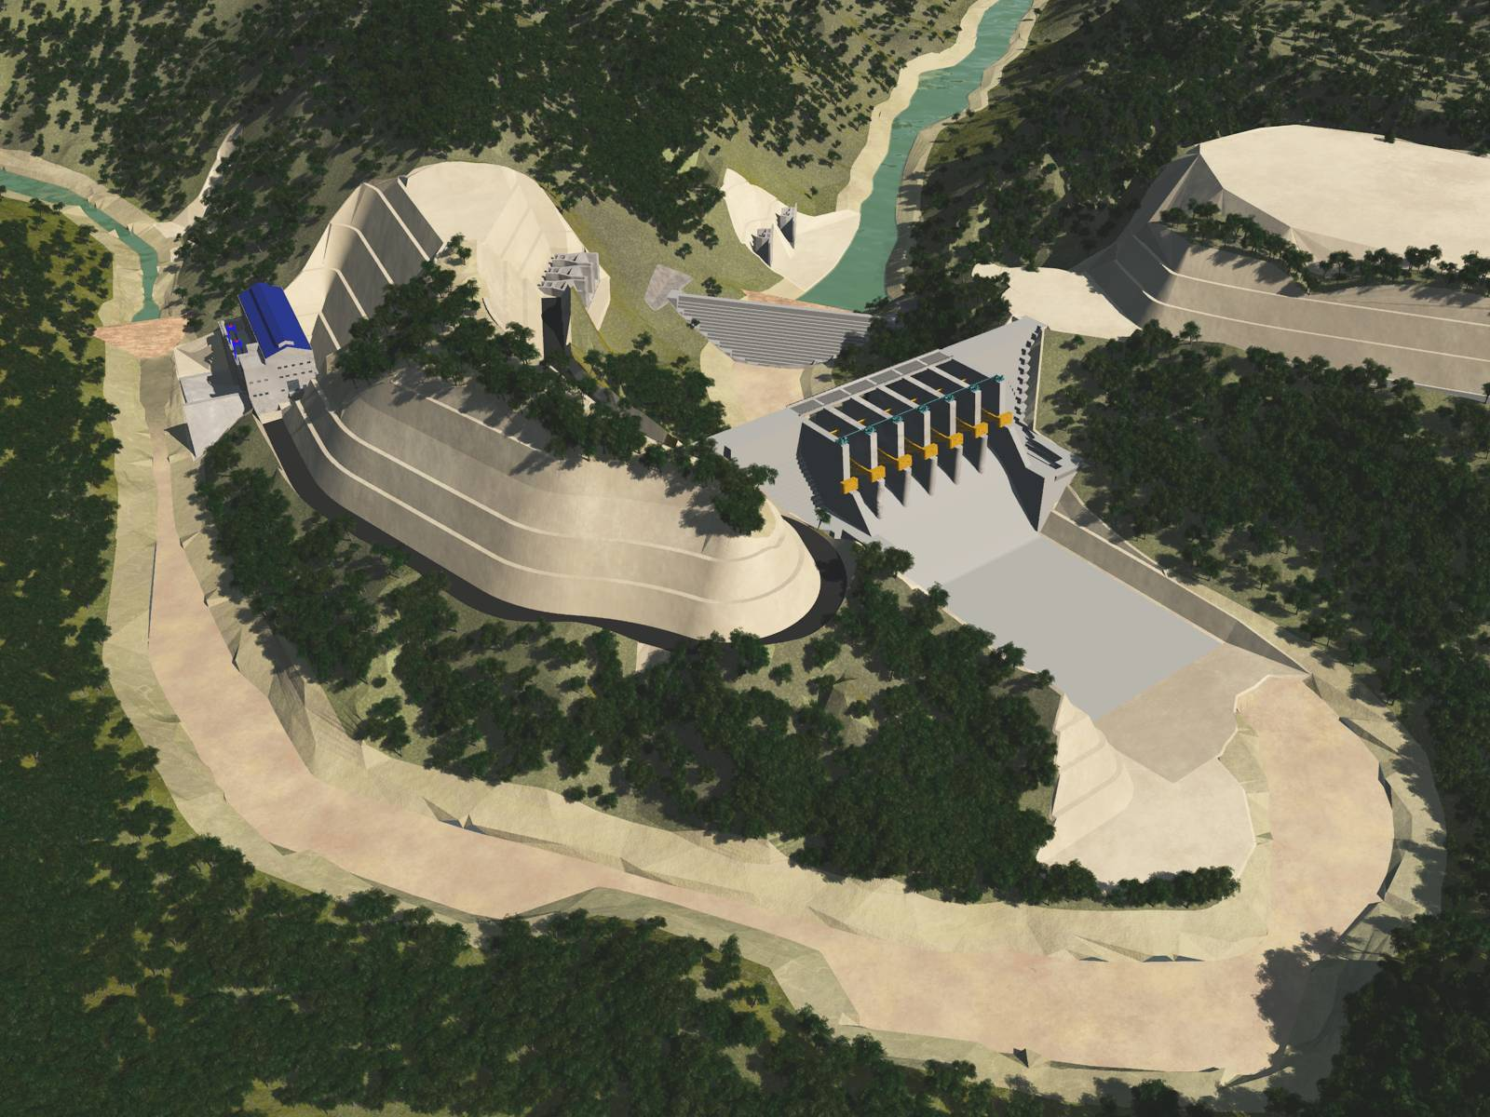

Diversion Tunnels
Cofferdam
Powerhouse
Intake
Weir and Spillway
Stilling Basin
Capacity: 102 MW RoR

Slide 12
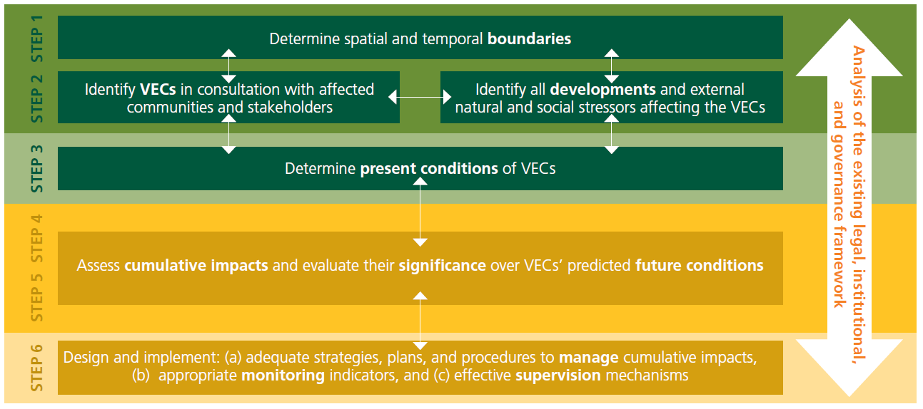

Slide 13
Total of 62 HPPs in the AJK
Four in the Poonch River

Slide 14
Study Area – Spatial Boundaries

Slide 16
The VECs
Fish Fauna
Sediment Load of the River
Surface Water Quantity – Flow
Landscape

Slide 17
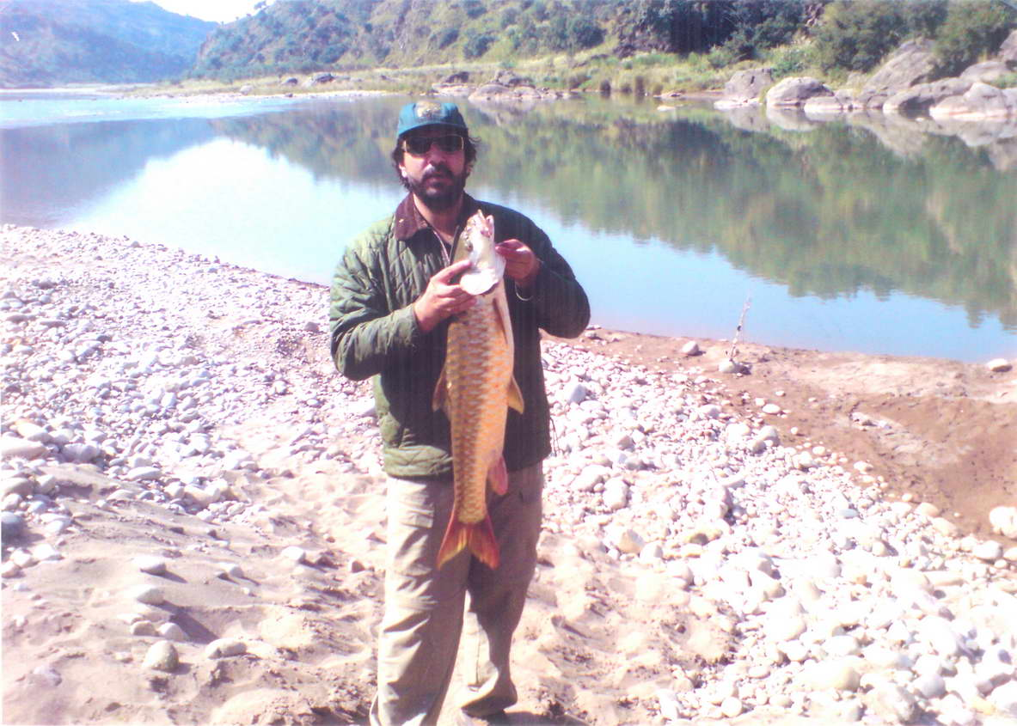

Slide 18
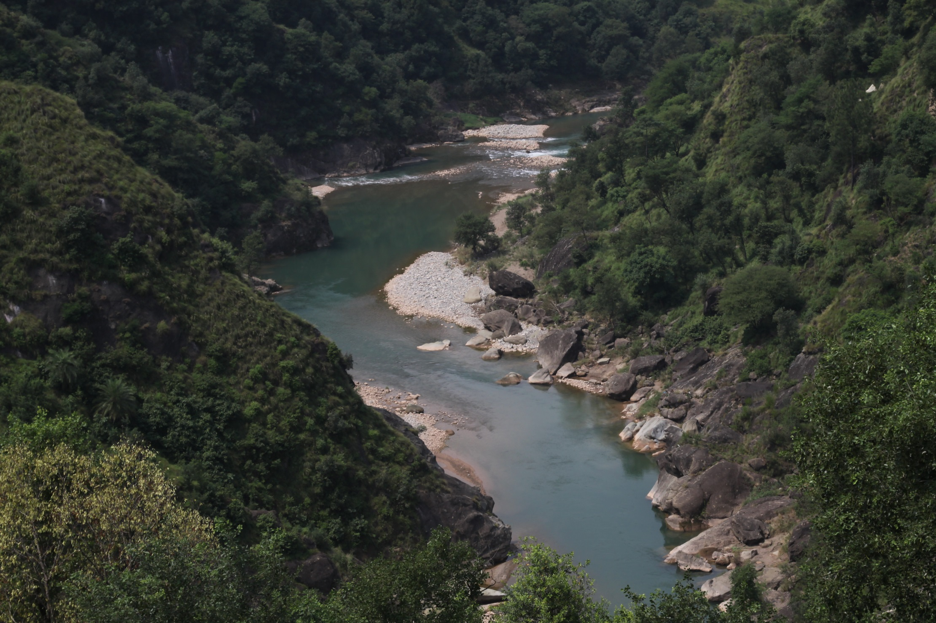

Slide 19
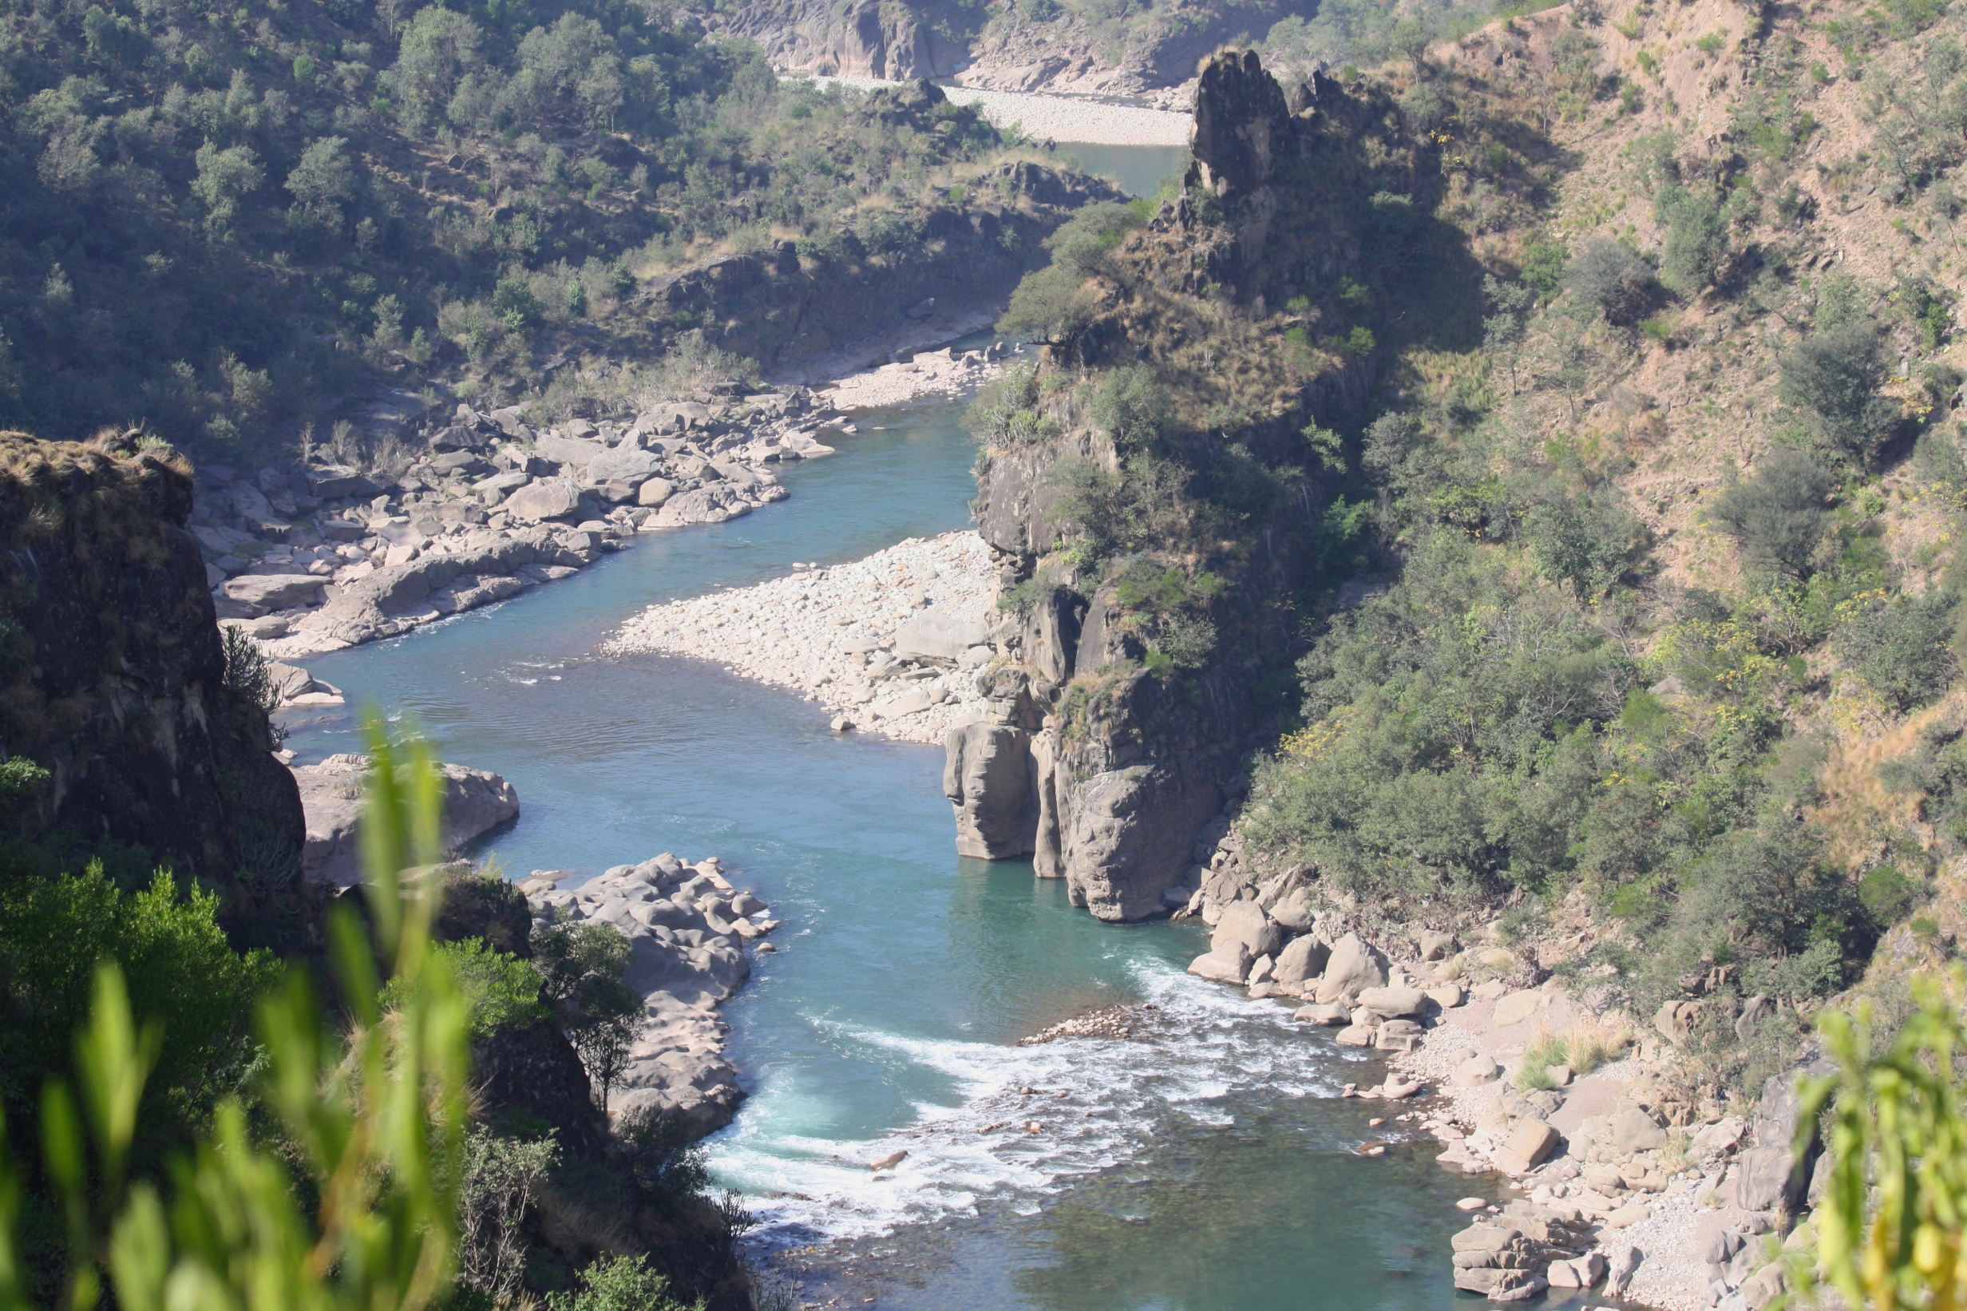

Slide 20
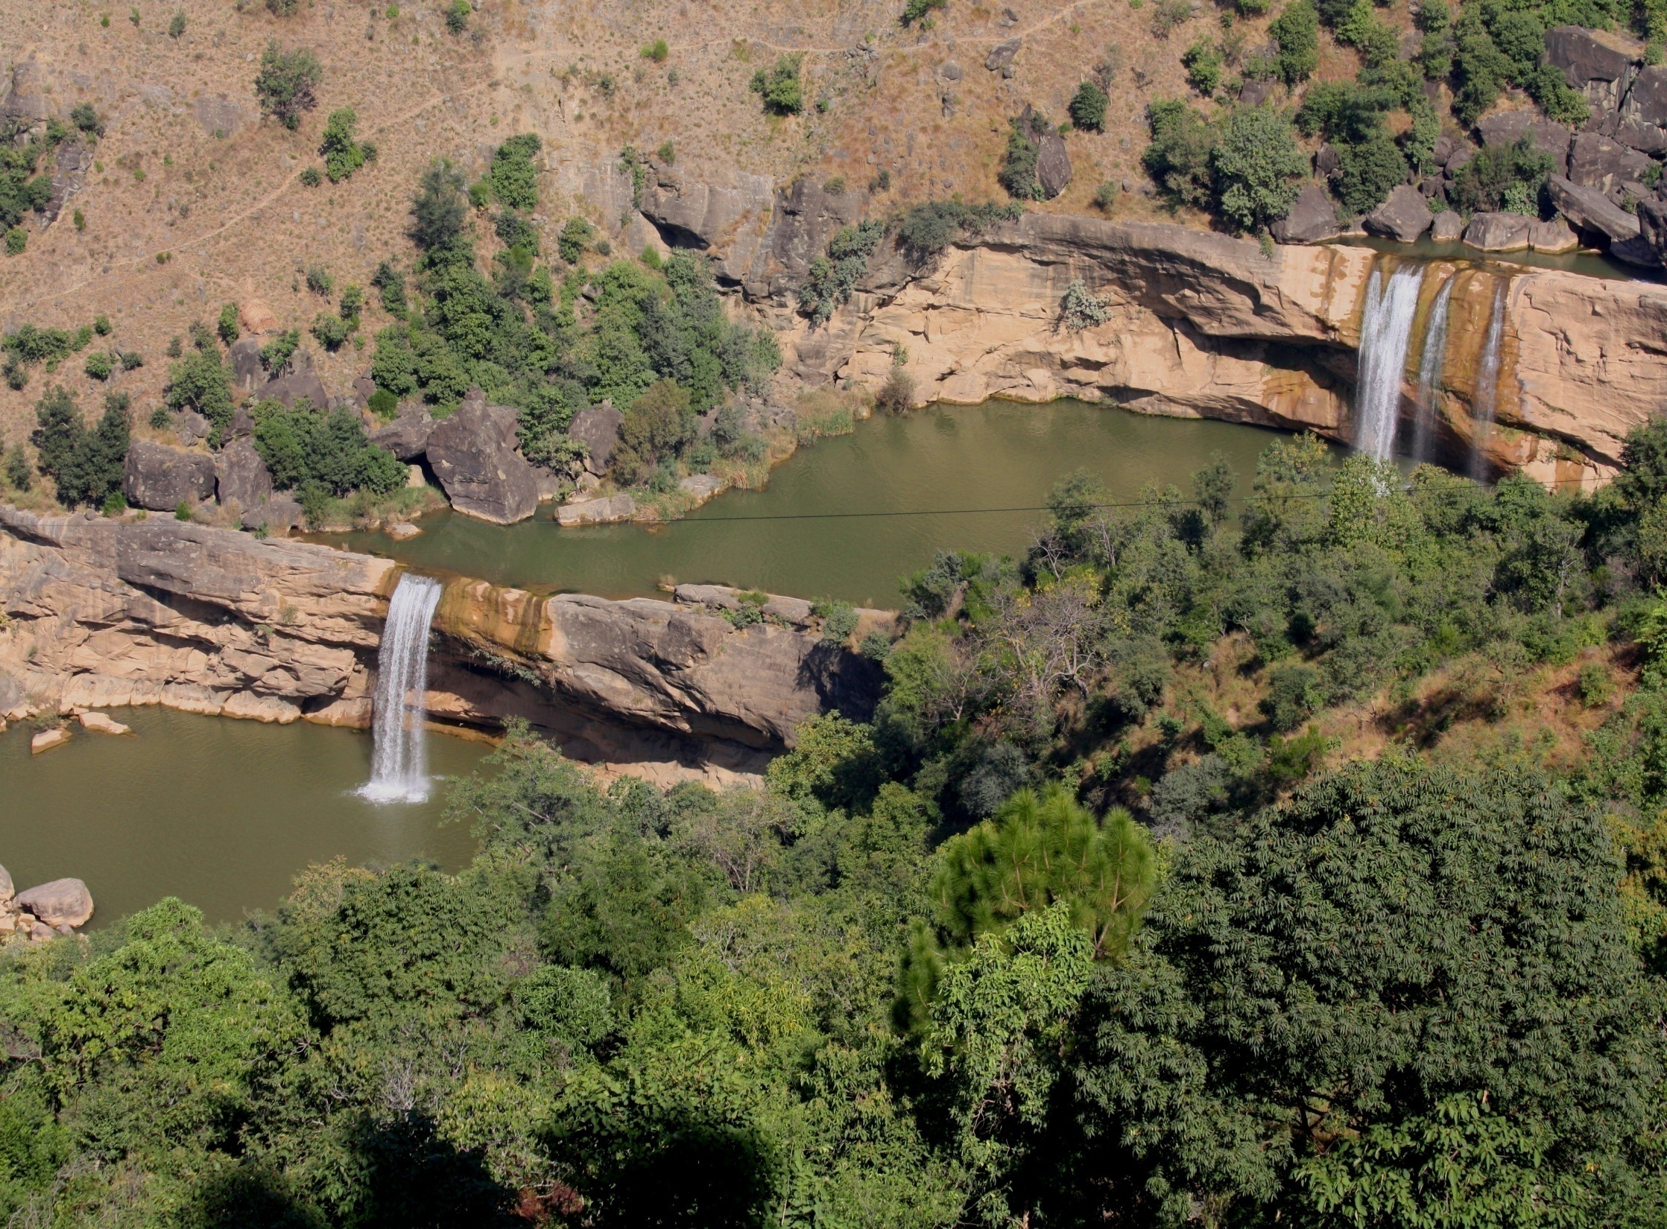

Slide 22
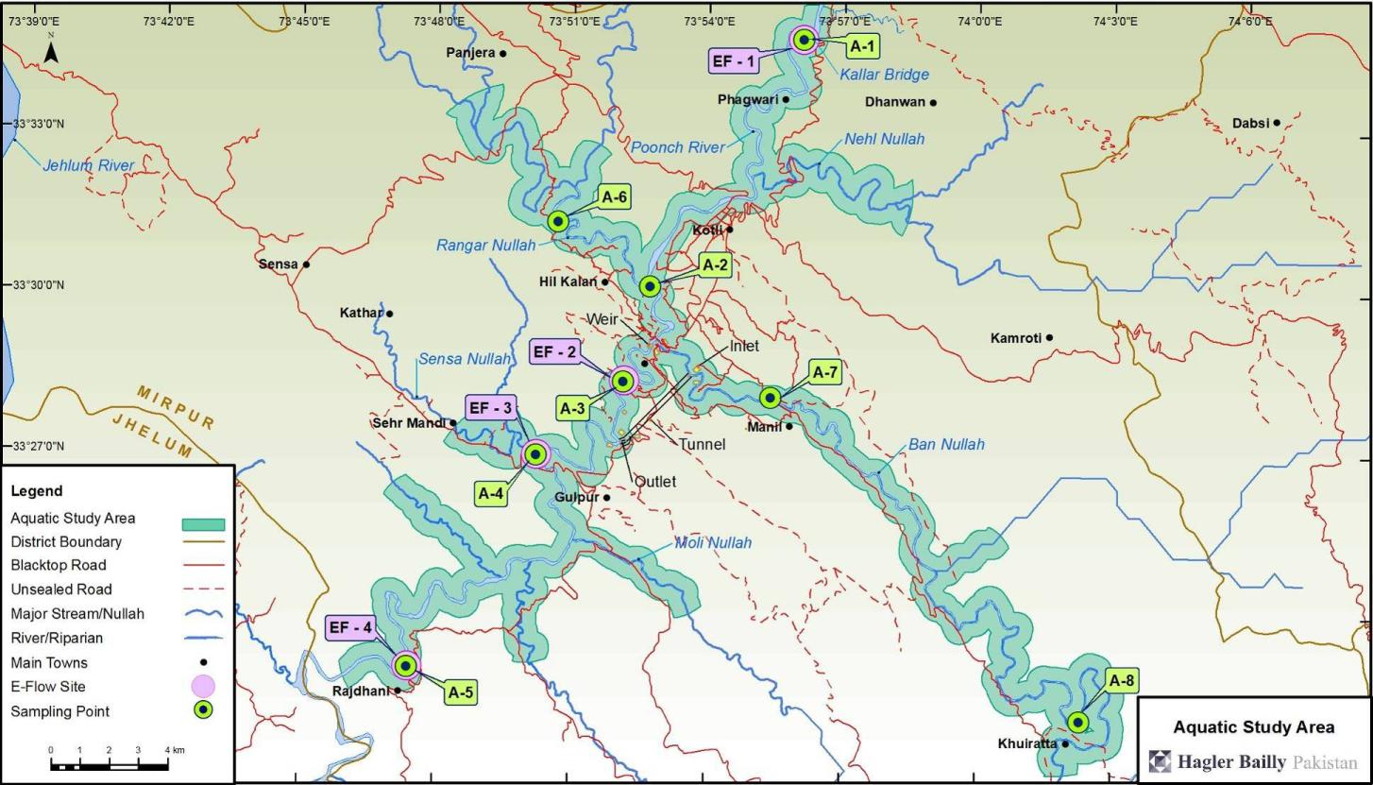
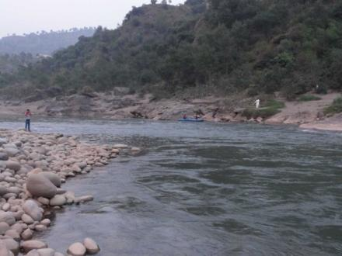
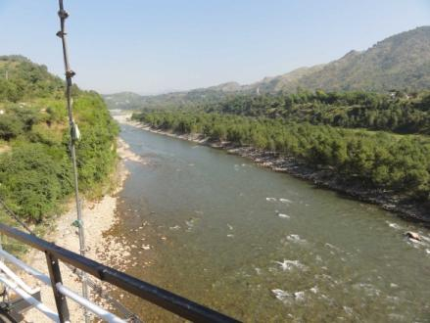
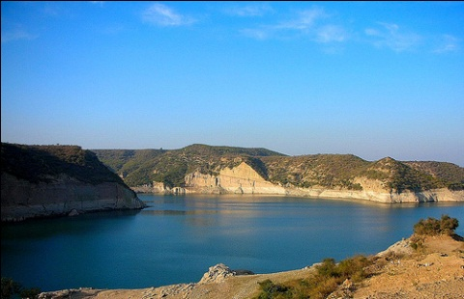
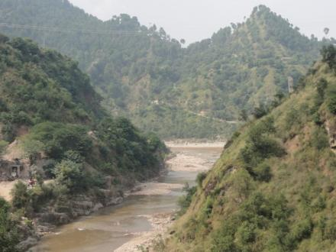
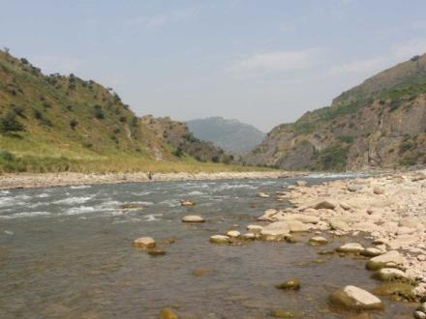
Aquatic Study
Extensive additional Baseline Data Collected Oct 2013 and April 2014

Slide 23
Hydraulic and Geomorphology Indicators
Hydraulics | Minimum 5-day dry season fish breeding habitat
 | Depth
 | Minimum 5-day average velocity (across the cross-section)
Geomorphology | Active channel width
 | Area of silt/mixed bars (regardless of level of inundation)
 | Area of cobble bars (regardless of level of inundation)
 | Median bed sediment size (armouring)
 | Depth of pools
 | Area of secondary channels and backwaters
 | Suspended sediment load.

Slide 24
Hydrology Indicators
Mean annual runoff
Dry season onset
Dry season minimum 5-day discharge
Dry season duration
Dry season average daily volume
Wet season onset
Wet season maximum 5-day discharge
Wet season duration
Wet season flood volume
Wet season minimum instantaneous discharge
Transition 1 maximum instantaneous discharge
Transition 2 average daily volume

Slide 25
Fish and Wildlife Indicators
Fish | Pakistani labeo
 | Mahaseer
 | Twin-banded loach
 | Kashmir catfish
 | Garua bachwaa
 | Snow trout
Wildlife | Fish-eating wildlife (Otter, common leopard)
 | Wildlife that drink from the main river (Barking deer)
 | Riverine insectivores (White-capped redstart)

Slide 26
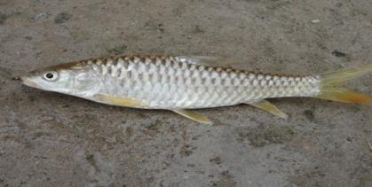
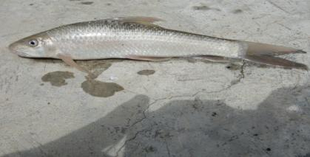
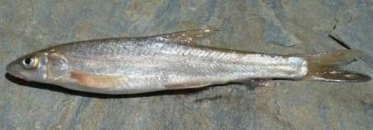
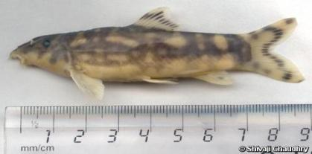
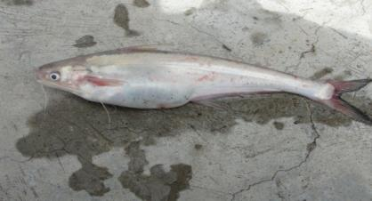
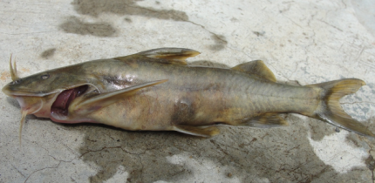
Fish Baseline – Indicator Species
Tor putitora
Labeo dyocheilus
Schizothorax plagiostomus
Botia rostrata
Clupisoma garua
Glyptothorax kashmirensis

Slide 27
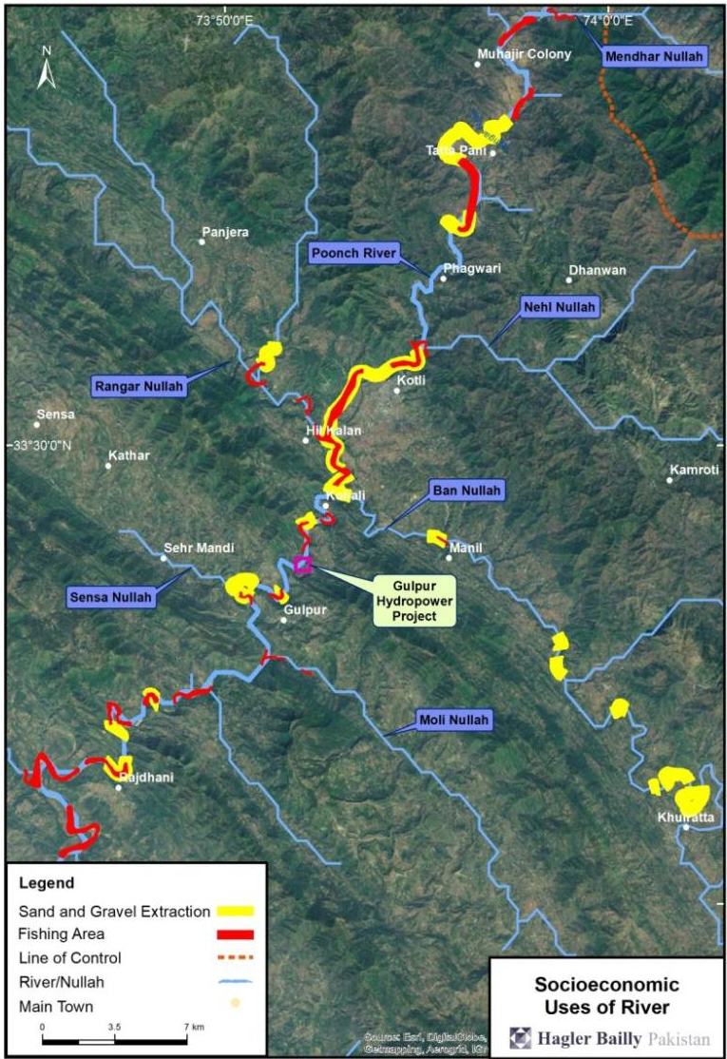
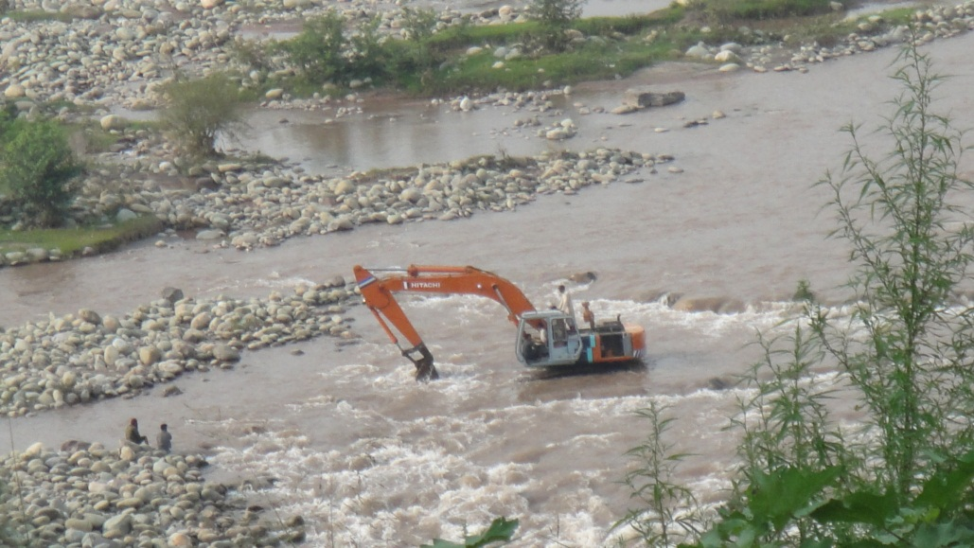
Mapped the Socioeconomic uses of water and pressures over the aquatic and riparian ecosystem.
Selective Fishing Pressure
Non-selective Fishing Pressure
Mining – Sand and Gravel
Mining – Cobble and Boulder
Water Quality

Slide 28
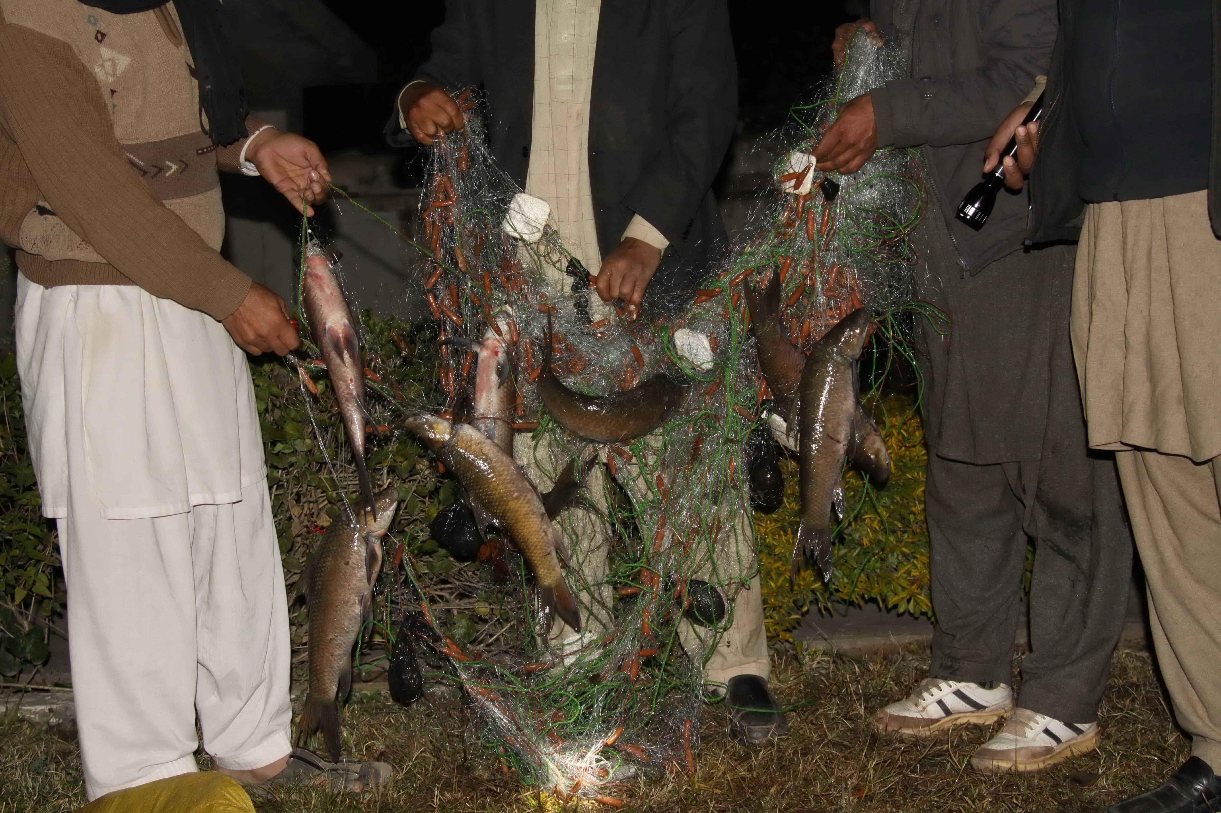

Slide 29
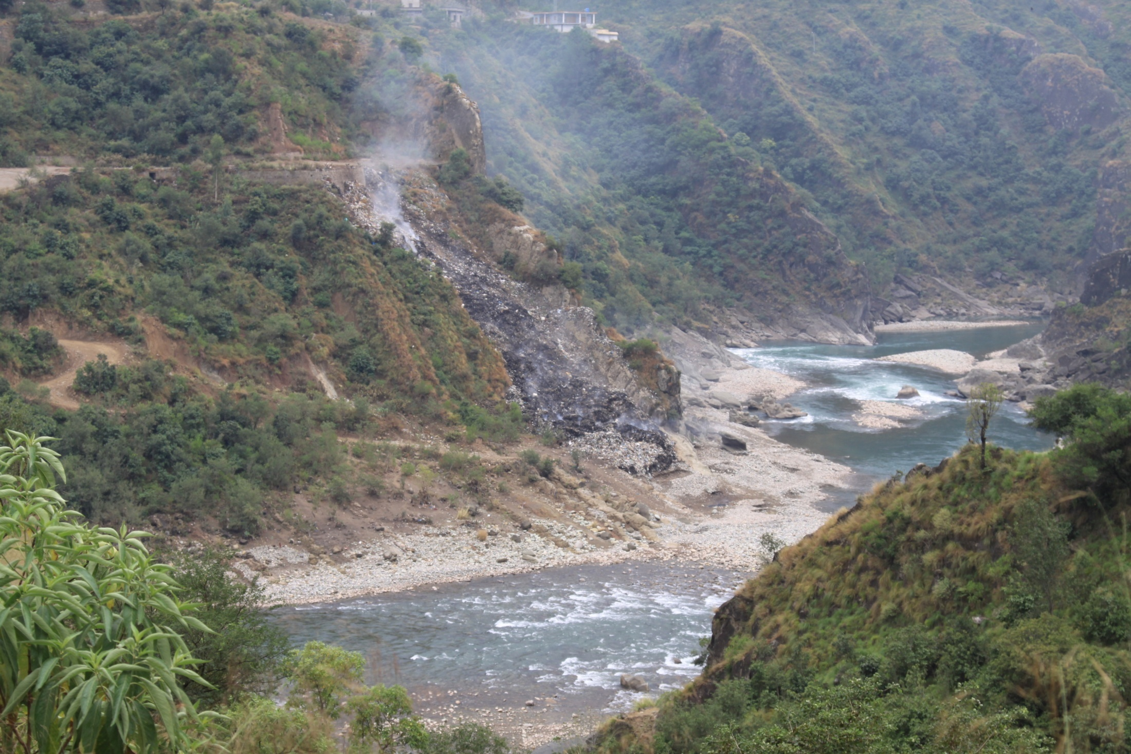

Slide 30
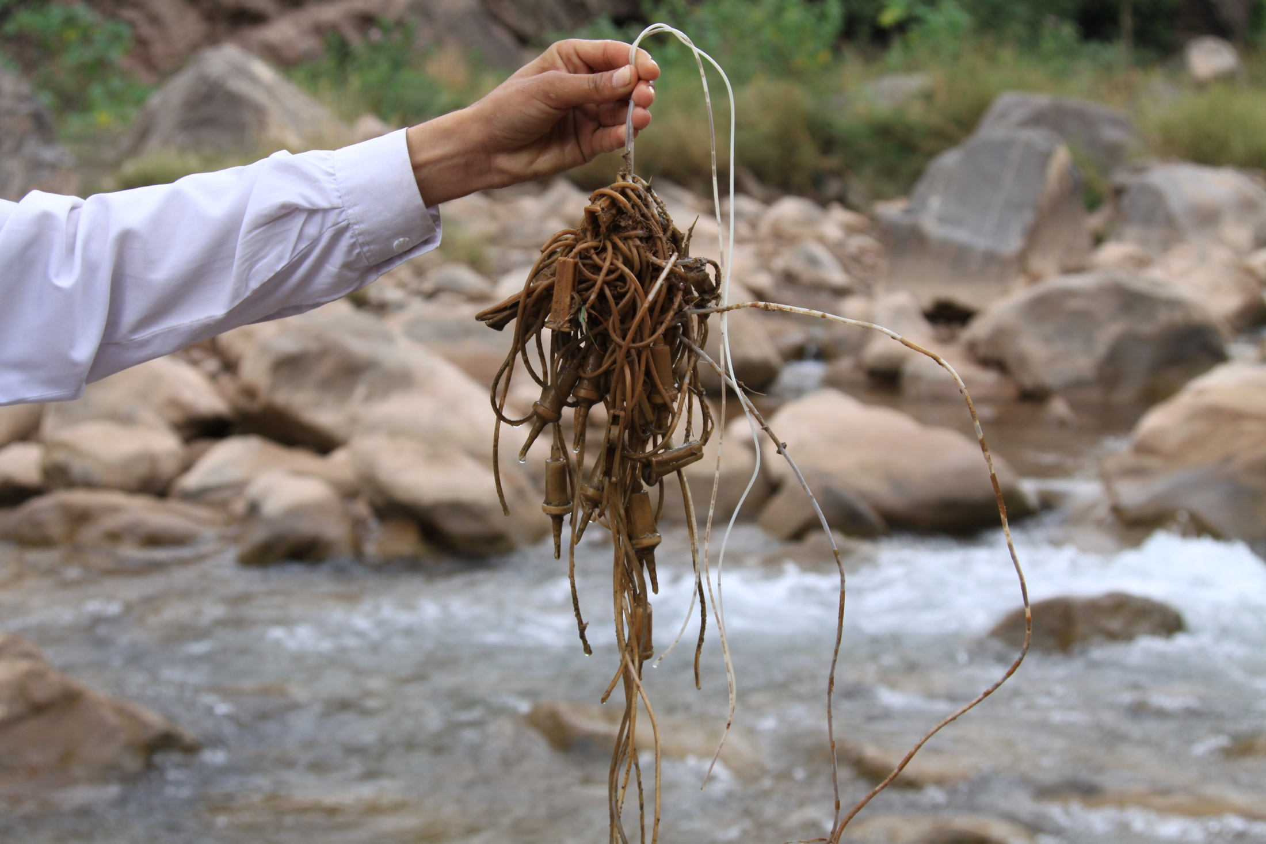

Slide 31
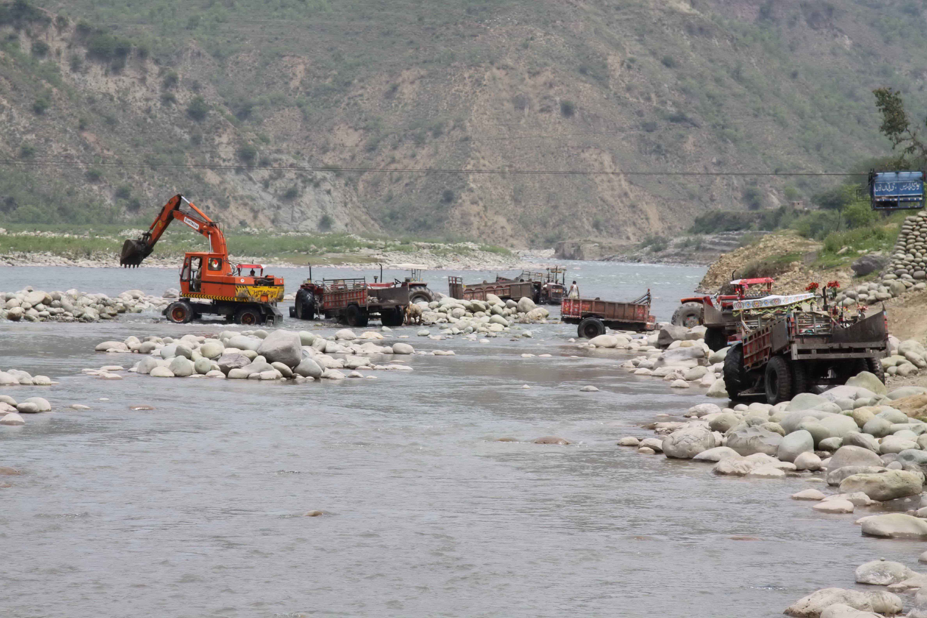

Slide 32
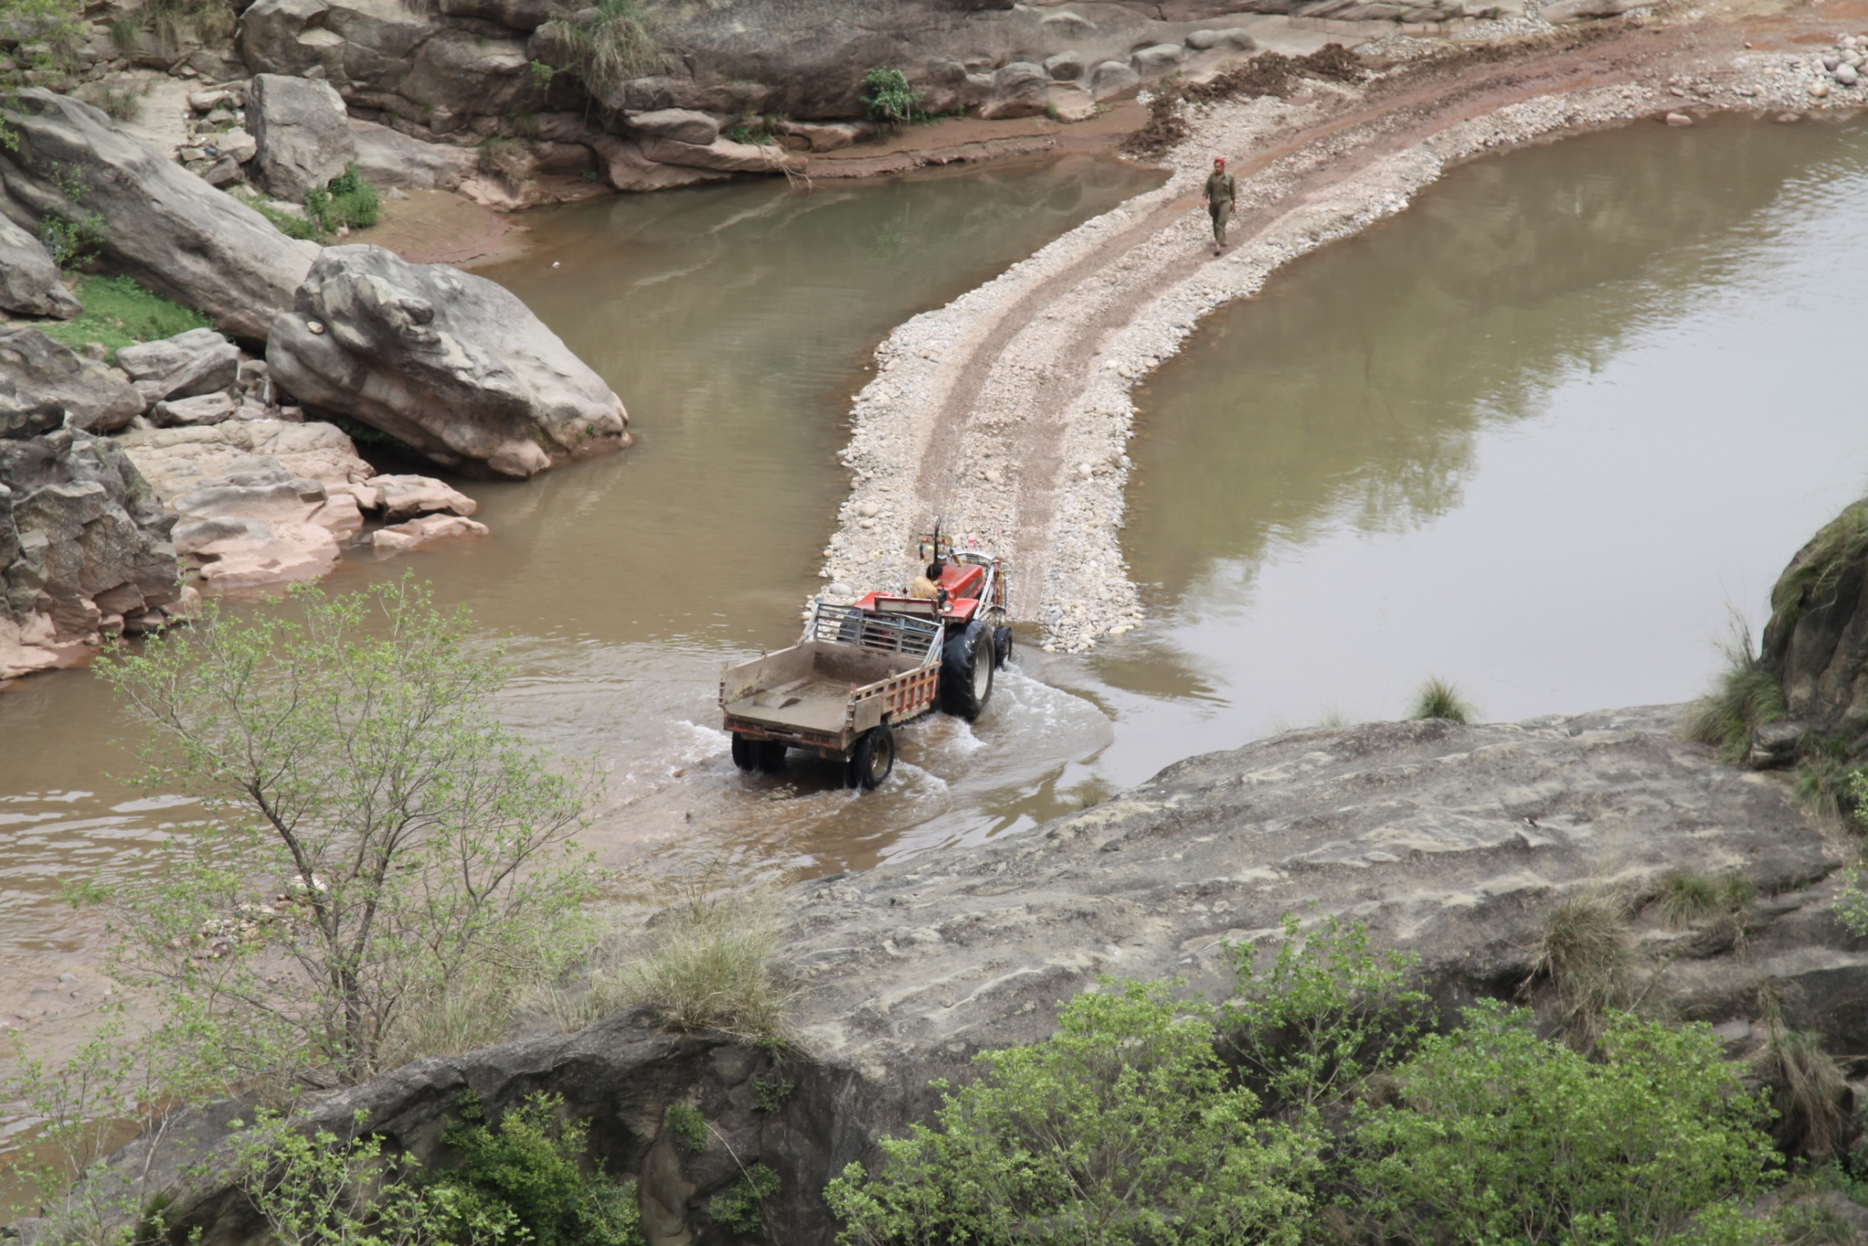

Slide 33
Definition of Present Ecological State
Ecological Category | PES % Score | Description of the Habitat
A | 90-100% | Still in a Reference Condition.
B | 80-90% | Slightly modified from the Reference Condition. A small change has taken place, but the ecosystem functions are essentially unchanged.
C | 60-80% | Moderately modified from the Reference Condition. Loss and change of natural habitat and biota has occurred, but the basic ecosystem functions are still predominantly unchanged.
D | 40-60% | Largely modified from the Reference Condition. A large loss of natural habitat, biota and basic ecosystem functions has occurred.
E | 20-40% | Seriously modified from the Reference Condition. The loss of natural habitat, biota and basic ecosystem functions is extensive.
F | 0-20% | Critically/extremely modified from the Reference Condition. The system has been critically modified with an almost complete loss of natural habitat and biota

Slide 34
Present Ecological Status of EF Sites
EF Site No. | Site | Description | Present Ecological State
1 | Kallar Bridge | Situated upstream of the full supply level of the reservoir. | C
2 | Borali Bridge | Situated between the weir and the tailrace | C
3 | Gulpur Bridge | Situated c. 7 km downstream of the tailrace. | C
4 | Billiporian Bridge | Situated c. 16 km downstream of the tailrace, c. 12 km upstream of the full supply level of Mangla Dam. | C

Slide 36
Approach for Cumulative Impact Assessment
Cumulative Impact Assessment in the Study Area was carried out in two phases:
  Impact of the project and other activities on VECs at basin wide level was first studied using a holistic environmental flow model
  Impact of planned and foreseeable hydropower projects on the VECs in the basin was then examined in light of the first study

Slide 37
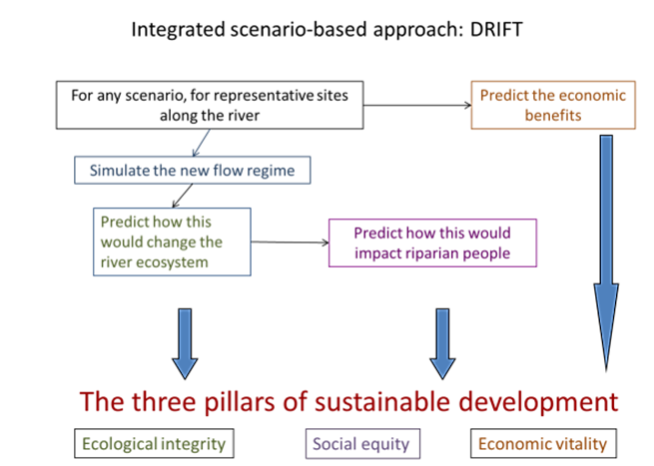
The DRIFT approach: Integrating Ecological,
Social and Economic Knowledge
Key features: approach; hydrology; indicators; DSS
DRIFT = Downstream Response to Imposed Flow Transformation

Slide 38
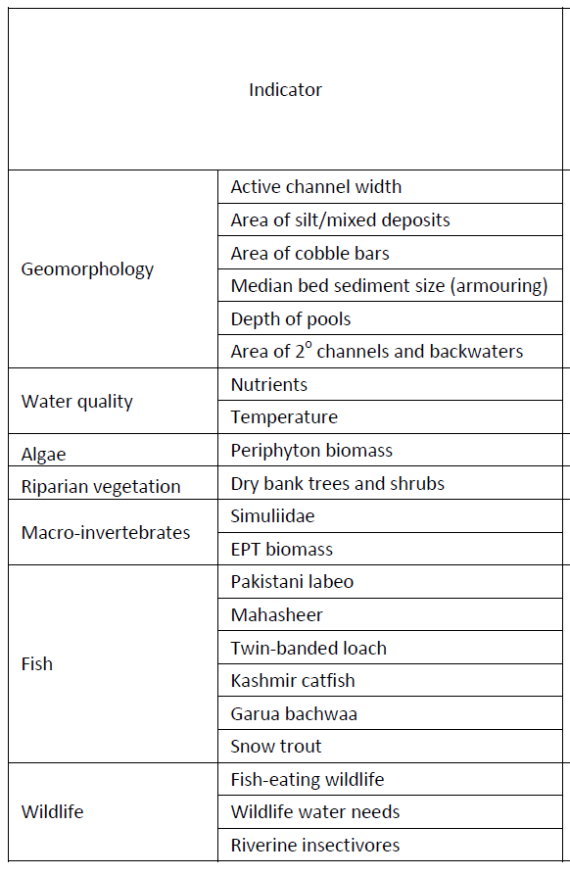
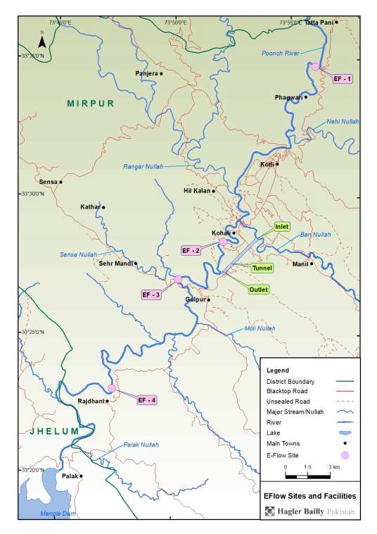
Southern Waters: Ecological Flow Assessment
Applied Downstream Response to Imposed Flow Transformations model (DRIFT):
This Ecological Flow modeling in addition to the standard hydrological averages, and often used wet-perimeter/ hydraulic data (e.g. depth, min 5-day average velocity, 5-day dry season fish breeding habitat), included
Hydrological Data Included in DRIFT
Mean annual runoff
Dry season onset
Dry season minimum 5-day discharge
Dry season duration
Dry season average daily volume
Wet season onset
Wet season maximum 5-day discharge
Wet season duration
Wet season flood volume
Wet season minimum instantaneous discharge
Transition 1 maximum instantaneous discharge
Transition 2 average daily volume

Slide 39
DRIFT modeling scenarios: Poonch River Protection Level vs Project design
Protection Level
Business as usual (BAU) = increase pressures in line with 2013 trends, i.e., 2013 pressures double in intensity over the next fifty years.
Protection Level 1 (Pro 1) = maintain 2013 pressure levels on the river; i.e., no increase in human-induced pressures over time
Protection Level 2 (Pro 2) = reduce 2013 levels of pressures by
50%, i.e., decline in pressures (relative to 2013) over time
No Dam in Place
  NDBAU: No dam in place; Protection Level BAU
  NDPro1: No dam in place; Protection Level 1
  NDPro2: No dam in place; Protection Level 2
Varying Levels of EFlows
  Minimum release of 4, 6, 8, 12, and 16 m³ were simulated for BAU and Pro 2 protection levels.
Peaking
  An 8.0 m³ minimum release and peaking-power releases. Protection level BAU.
Biodiversity Action Plan will be required for implementation of Protection Level 2 Scenario as it assumes a basin level protection

Slide 40
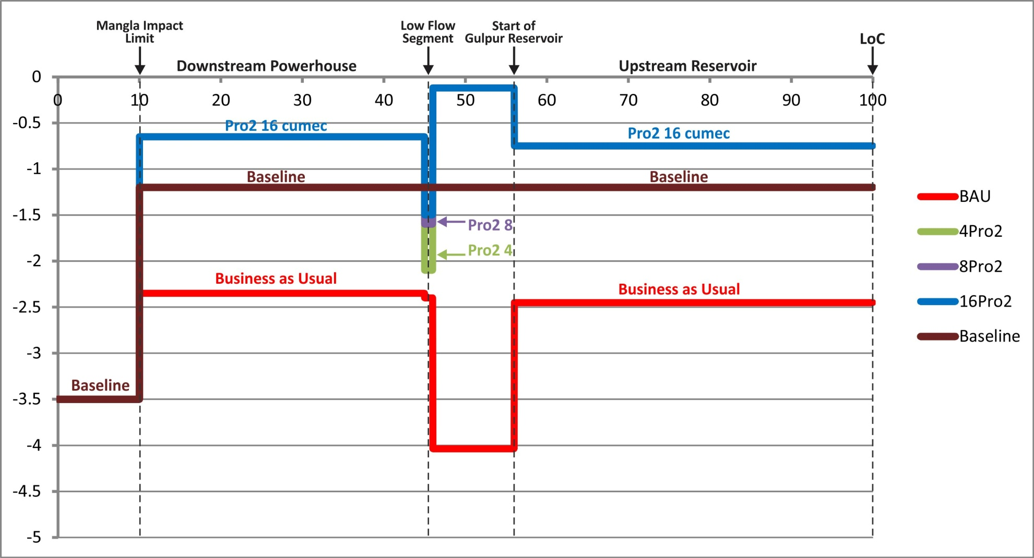
Ecosystem Integrity Along the Length of the River

Slide 41
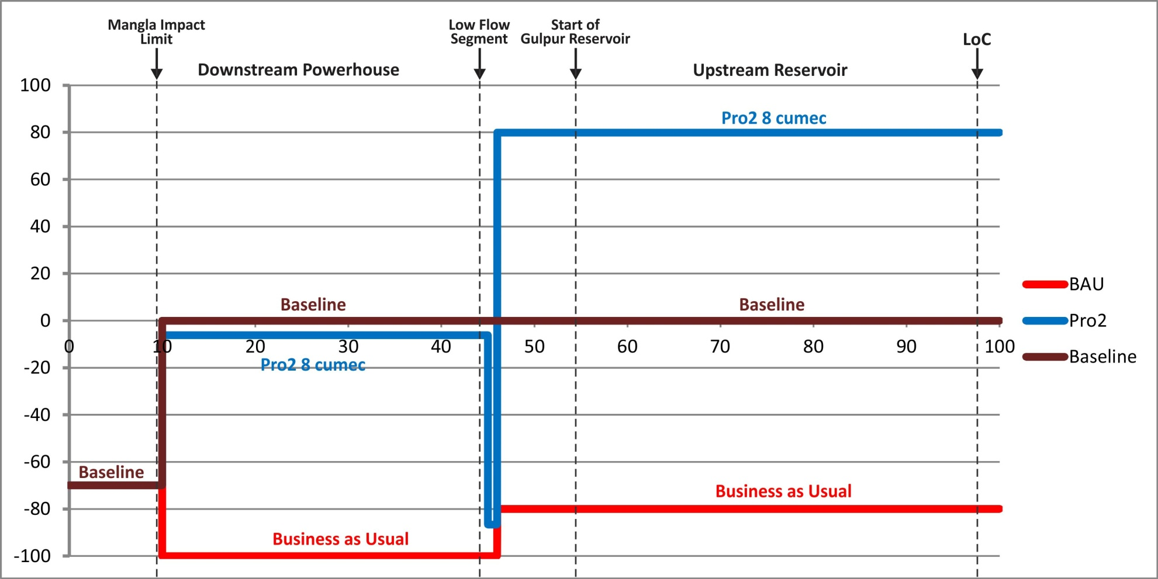
Impact on Kashmir Catfish
Please note that in the low-flow segment still there is an 92% loss of Kashmir Catfish

Slide 42
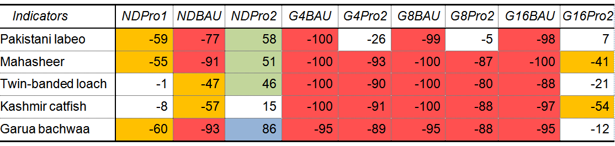
Impacts Just Downstream of
Dam – Low Flow Zone – EFlow Site 2
NDPro1: No dam in place; Protection Level 1
NDBAU: No dam in place; Protection Level BAU
NDPro2: No dam in place; Protection Level 2
G4BAU A 4 m3s-1 minimum release. Protection level BAU.
G4Pro2 A 4 m3s-1 minimum release. Protection Level 2.
G8BAU An 8.0 m3s-1 minimum release. Protection level BAU.
G8Pro2 An 8.0 m3s-1 minimum release. Protection Level 2.
16BAU A 16 m3s-1 minimum release. Protection level BAU.
G16Pro2 A 16 m3s-1 minimum release. Protection Level 2.

Slide 43
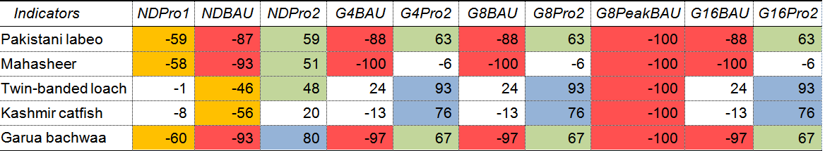
Impacts Downstream of Tail Race – Eflow Site 3
NDPro1: No dam in place; Protection Level 1
NDBAU: No dam in place; Protection Level BAU
NDPro2: No dam in place; Protection Level 2
G4BAU: A 4 m3s-1 minimum release. Protection level BAU.
G4Pro2: A 4 m3s-1 minimum release. Protection Level 2.
G8BAU: An 8.0 m3s-1 minimum release. Protection level BAU.
G8Pro2: An 8.0 m3s-1 minimum release. Protection Level 2.
16BAU: A 16 m3s-1 minimum release. Protection level BAU.
G16Pro2: A 16 m3s-1 minimum release. Protection Level 2.

Slide 44
Evaluation of Barrier to Fish Movement
Upstream migration will be halted by the weir, but there will be some downstream movement through the spills.
The bulk of the tributaries of the Poonch River that are used for breeding by Pakistani Labeo, Mahaseer are located upstream of Gulpur HPP.
Fish restricted to the lower part of the Poonch River will breed in the main river to some extent
Pakistani Labeo, Snow Trout and Mahaseer will most likely colonize the reservoir, which may lead to a slight increase in their populations upstream of the dam.
Bulk of the favoured breeding sites for Garua are located downstream of the Gulpur weir. Garua is also unlikely to colonize the reservoir. Thus, it is expected that the population upstream of the dam will be compromised by the weir.

Slide 45
Peaking Operation Discarded
A peaking operation can be detrimental to the ecology downstream of the dam.
Low flows normally occur in the section of the river starting just below the dam, to the point where water is added back into the river at the outlet of the of the power house.
With a peaking operation low flows are extended downstream of the power house as well during the period the power house is shut down to accumulate water in the reservoir upstream.
The river ecology which is adapted to normal daily and seasonal variations in flows is severely impacted by the daily long dry spells.
A peaking operation will result in deterioration starting from a Mid Category C river (Moderately Modified from Reference Condition) to a Mid-Category E river (Seriously Modified) under which the loss of ecosystem functions is extensive.

Slide 46
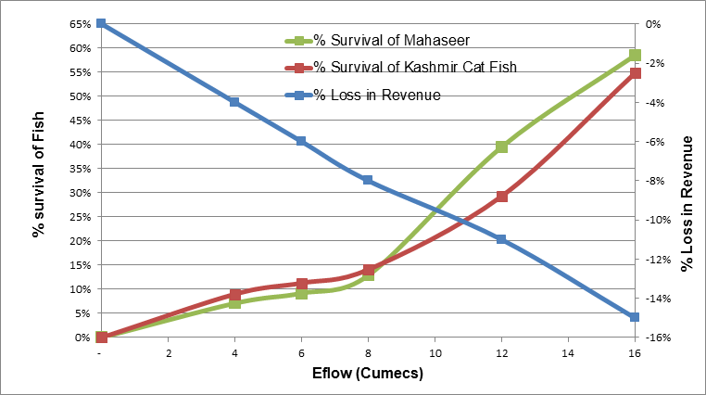
Tradeoffs: Economic Benefits vs Survival of Fish Populations

Slide 47
Environmental Flow and Eflow Management Plan
Given the limited length of the low flow section for the Project (0.7 km) and commitment to a non-peaking operation, there is limited advantage gained by increasing Eflow at the expense of power generation. After consultation with the stakeholders the EPA approved a minimum release of 4 cumec at dam subject to implementation of a BAP to achieve Enhanced Protection.
An Eflow management plan was prepared to specify operating rules and monitoring mechanisms

Slide 48
Findings and Conclusions from EcoFlow Assessment
Non-Project Scenario:
With Business as Usual (BAU) or Pro1 -> low Category D
Pro2 -> low Category B river.
Project Scenario:
Slightly deterioration with dam in place under BAU – Pro1 –> main impact on dewatered segment.
The barrier effect of the dam as felt upstream of the dam will be minimal under all BAU, Pro1 and Pro2 scenarios.
BAU -> mid-Category E.
Under Pro2 - > border line between Category B and C.
A peaking operation -> to a Mid-Category E under all scenarios
Conclusions:
Need to operate as true run-of-river (non-peaking).
The impact of poor protection will be far higher than that of dam and the reduced flows.
The contribution of good protection measures will more than compensate for harm done by the HPP.
Given the limited length of the low flow section, increasing minimum flow release from 4-16 m³ will not result in any significant improvement in the ecological condition of the river. Thus eflow of 4 m³/s was suggested.

Slide 49


Cumulative Impacts

Slide 51
Cumulative Impact on Ecological Integrity
B = blue, B/C and C = green, C/D = white, D = orange, No river remaining = red
River Reach |  | 2013 | Sequential implementation of:
 |  |  | Gulpur HPP | Parnai HPP | Sehra HPP | Kotli HPP | Rajdhani HPP
Poonch River upstream of LoC | Parnai weir to LoC | B | B | C/D | C/D | C/D | C/D
Poonch River downstream of LoC | LoC - 5 km | B/C | B/C | C/D | D | D | D
 | 10 | B/C | B/C | C | No river remaining | No river remaining | No river remaining
 | 15 | B/C | B/C | C | D | D | D
 | 20 | B/C | B/C | C | D | D | D
 | 25 | B/C | B/C | C | D | D | D
 | 30 | B/C | B/C | C | C | No river remaining | No river remaining
 | 35 | B/C | B/C | C | C | D | D
 | 40 | B/C | B/C | C | C | D | D
 | 45 | B/C | No river remaining | No river remaining | No river remaining | No river remaining | No river remaining
 | 50 | B/C | No river remaining | No river remaining | No river remaining | No river remaining | No river remaining
 | 55 | B/C | D | D | D | D | No river remaining
 | 60 | B/C | B/C | B/C | C | C/D | No river remaining
 | 65 | B/C | B/C | B/C | C | C/D | No river remaining
 | 70 | B/C | B/C | B/C | C | C/D | No river remaining
 | 75 | B/C | B/C | B/C | C | C/D | D
 | 80 | B/C | B/C | B/C | C | C/D | D
 | 85 | B/C | B/C | B/C | C | C/D | D
 | 90 | B/C | B/C | B/C | C | C/D | D
Mendhar Nullah |  | B | B | D | D | D | D

Slide 53
Project Level Proposed Approach
Given the state of protection in the Poonch River, there will not be much of environmental resource left to protect if the present trends continue.
Implement a Biodiversity Action Plan (BAP) to address basin level protection of wildlife which is in jurisdiction of AJK Fisheries and Wildlife Department.
Implementation of the BAP requires commitment from the government. Additional resources for the BAP will be provided by the Project.
The government and Project owner signed an agreement to implement the BAP

Slide 54
Biodiversity Action Plan (BAP)
BAP includes:
  Ecological Flow Management Plan and continued monitoring;
  Support AJKFWD in the construction and maintenance of a hatchery for Mahaseer on the Poonch River;
  Help the AJKFWD development of a strong management plan for the Mahaser National Park;
  Effective watch and ward system to reduce illegal and indiscriminate hunting and killing of wildlife (both aquatic and terrestrial) and removal of vegetation that is important for supporting biodiversity;
  Bans on non-selective fishing, fishing in tributary breeding grounds, and fishing during breeding season;
  Specific conservation measures such as increased park staff, patrols and mining inspectors;
  Limitations on and designated areas for sediment mining, and banning sediment mining in ecologically sensitive areas;
  Banning of livestock grazing and wood collection in sensitive areas;
  Environmental awareness events / training for local communities;
  Protection of tributaries for Golden Mahaseer breeding; and
  Enhance sand/gravel riffle habitat for the Kashmir catfish.

Slide 55
Basin Level: Proposed Approach
Written commitment from AJK EPA to request “net gain and betterment of the Mahaseer-Poonch River National Park” as a requirement for any new HPP development.
Detailed downstream flow management plan (DRIFT)
Extensive Biodiversity Action Plan (BAP)
IFC working in a “Landscape” approach at the Jhelum-Poonch watershed using donor funding via Hydro Advisory widow.
  Biodiversity Strategy developed FY2015-16
  Implementation 2017-2021

Slide 56
Biodiversity Strategy
  DRIFT modeling for the complete system – commit all developers to avoid peaking.
  Putting in place a protection system for the Mahaseer National Park partly financed by the Project and implemented with support from an independent Implementation Organization, and protect other areas of the basin – potentially to be Mahaseer and Kashimir Catfish sanctuaries.
  Commitment by the Wildlife Departments of the three affected provinces to make staff available for protection, and coordination with other government line departments and developers.
  Commitment by Wildlife Department to provide legal authority to the Independent Organization for exercising powers under wildlife legislation (e.g. Himalayan Wildlife Foundation)
  Construction of a Mahaseer / Kashmir catfish hatchery for stocking of fish in affected areas and avoid inbreeding / formation of subpopulations.
  Basin-wide Mining Plan to ensure a balance between meeting community needs for sand and gravel and integrity of aquatic habitats
  Monitoring by an Independent Third Party on a long term basis and
  Long term Capacity Building and Oversight and monitoring by the Provincial EPA/Wildlife Management Departments

Slide 57

http://www.ifc.org/wps/wcm/connect/news_ext_content/ifc_external_corporate_site/news+and+events/news/how+two+fish+are+changing+hydropower+in+pakistan

Slide 58




In the News
“Consistent with environmental guidelines of International Finance Corporation and Asian Development Bank, the Project has been designed to achieve net gain in population of endangered species through implementation of a biodiversity action plan that would be partly financed by electricity revenues from the Project.
This novel approach to conservation has support from independent environmental organizations, prominent among which were Himalayan Wildlife Foundation and World Wildlife Fund (WWF-Pakistan), which were actively consulted during Project development”.

Slide 59
http://www.dailytimes.com.pk/business/18-Mar-2015/biodiversity-action-plan-to-protect-endangered-fish
http://tribune.com.pk/story/854885/gulpur-power-plant-ajk-govt-south-korean-firm-sign-agreements/
http://thefinancialdaily.com/NewsDetail/185371.aspx
http://www.sabahnews.net/national/biodiversity-action-plan-of-102mw-gulpur-project-to-protect-endangered-fish/
http://www.southasianmedia.net/stories/pakistan/english-language-media/gulpur-power-plant-ajk-govt-south-korean-firm-sign-agreements-story
http://www.pakistantoday.com.pk/2015/03/17/business/ajk-powering-up-with-102mw-hydro-project/
http://www.lhrtimes.com/2015/03/16/three-agreements-signed-for-102mw-gulpur-project-in-ajk-241961/
http://www.dawn.com/news/1289790/earthly-matters-saving-the-mighty-mahasheer

Slide 60

Thank You
https://www.youtube.com/watch?v=70woqAm4oYg
pcardinale@ifc.org

